Slide 1
SMART GARBAGE BIN
Guided By :
PRESENTED BY :
GOWRIHA B (22AI059)
CHRISTY ANN NAVEENA(22AI008)
ILAKHIYAA(22AI018)
TEAM NO
22AIC14 & INTERNET OF THINGS AND IT’S APPLICATION

Slide 2
Abstract
The growing need for efficient waste management solutions in urban areas has led to the development of smart systems that leverage Internet of Things (IoT) technology.
A Smart Garbage Bin system aims to address issues such as overflowing bins, inefficient collection schedules, and environmental pollution.By embedding sensors in garbage bins, the system monitors the fill level in real-time, allowing for optimized waste collection routes and schedules.

Slide 3
Data from these sensors are transmitted to a central platform through IoT networks, enabling municipalities or waste management companies to efficiently allocate resources.
Additional features, such as odor detection and temperature monitoring, can help in identifying hazardous waste early.
This system minimizes human intervention, reduces operational costs, and promotes a cleaner environment. The integration of IoT into waste management is a step toward creating smarter, sustainable cities.

Slide 4
Objectives:
1. Efficient Waste Collection: Optimize waste collection routes and schedules by providing real-time data on bin fill levels, reducing unnecessary trips to empty bins that are not full. 2. Overflow Prevention: Prevent the overflowing of garbage bins by sending alerts when bins reach a certain capacity, ensuring timely waste collection. 3. Cost Reduction: Minimize operational costs by reducing fuel consumption, labor, and time spent on inefficient waste collection routes. 4. Environmental Benefits: Reduce pollution and littering in public spaces by ensuring bins are emptied before they overflow, contributing to a cleaner environment. 5. Resource Optimization: Enable waste management companies to allocate resources like trucks and personnel more efficiently based on real-time data. 6. Data-Driven Decisions: Use data analytics from the system to improve future waste management planning and decision-making, such as adjusting collection frequency based on patterns. 7. Health and Safety Monitoring: Incorporate sensors to detect hazardous conditions, such as unpleasant odors or high temperatures, to prevent health and safety risks. 8. Public Awareness: Promote responsible waste disposal by raising public awareness through the visibility of smart technology in action.

Slide 5
Components Required:
Microcontroller or Microprocessor
Ultrasonic Sensors
IR Sensors or Weight Sensors
Gas, Odor Sensors and Temperature sensors
Wi-Fi or GSM Module
Cloud Server or IoT Platform

Slide 6
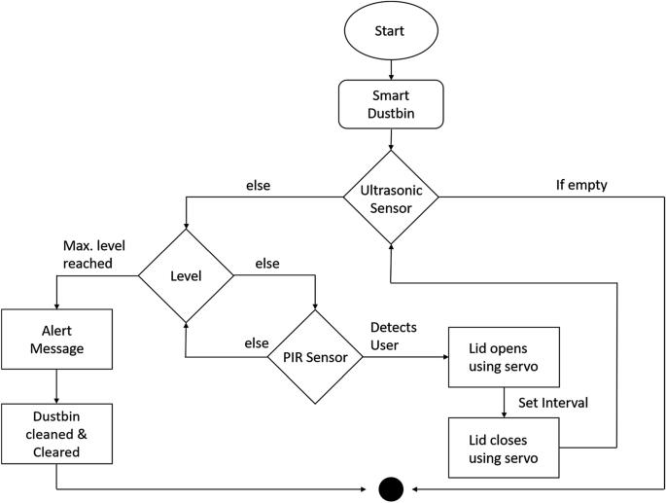
Flow Diagram:

Slide 7
Implementation: (Hardware or software)
Hardware Implementation:Microcontroller/Processor (e.g., Arduino, ESP32)
Sensors (Ultrasonic, Gas, Temperature, Weight)
Power Supply and Management (Battery, Solar)Communication Module (Wi-Fi, GSM)Enclosure for Protection
Software Implementation: Microcontroller Programming (Sensor Data Collection, Alerts)
IoT Platform Setup (Data Transmission, Storage)Mobile App or Web Dashboard (Monitoring and Alerts)
Integration:Sensor and Microcontroller ConnectionCommunication Setup (Wi-Fi, GSM)
Cloud Platform (ThingSpeak, Blynk, Firebase, AWS IoT)
Real-Time Monitoring and Alert System

Slide 8
THANK YOU

